Slide 2
Contents
What satellites can do
Terminology
Current and future capabilities
Copernicus
Commercial opportunities such as NovaSAR and COSMO-SkyMed
Emergency Access – Disaster Charter – Alice Bunn
Navigation tools Galileo and EGNOS
Communication tools
Funding – Richard Turner
Access to expertise
Conclusion
Notes:
ADDED SOME STUFF IN HERE AS WE NEED TO GIVE THEM A ROUNDED OVERVIEW

Slide 3
What do satellites do?
Earth Observation (EO) – weather forecasting
Global Navigation Satellite System (GNSS) – in car sat nav
Communications – broadband to remote areas
Scientific Research

Slide 4
Terminology
Spatial Resolution – is the size on the ground that equates to a single pixel in the image
Spectral Resolution –wavelength width of the different frequency bands recorded
Radiometric Resolution – number of different intensities of radiation the sensor is able to distinguish. Typically 8 to 14 bits = 256 levels of gray scale and 16384 shades
Temporal Resolution – frequency of flyovers. Is only relevant in time-series studies
Swath width – area covered on the ground by the sensor
Synthetic Aperture RADAR – uses relative motion between sensor and target to form high resolution images
Tasking

Slide 5
Important EO Terminology for users
Spatial Resolution: amount of detail in the image
Very High Resolution (VHR): <1m = Cars
High Resolution (HR): 1-10m = Cars Houses
Medium Resolution (MR): 10-50m = Olympic swimming pool
Low Resolution (LR): >50m = Football pitch is 100m long
Swath Size: area covered in the image
Is what I see the ‘true colours’? Depends on sensor and processing of image, chosen by user
Tasking: Telling the satellite where and when to capture data
Notes:
What does the diagram represent? – is it relevant? Not sure?! Can we assume people are aware there are 3 primary colours….. ☺

Slide 6
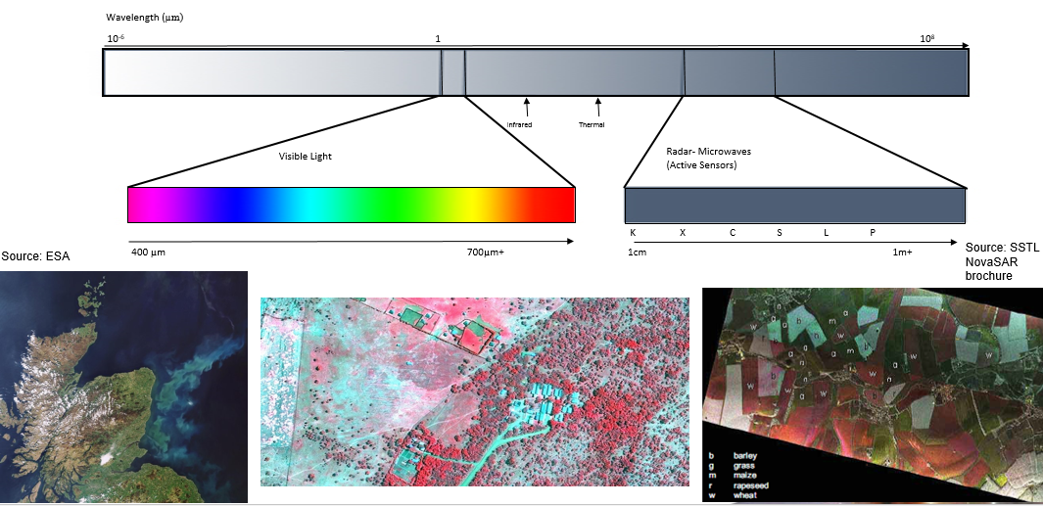
EO Satellites

Slide 7
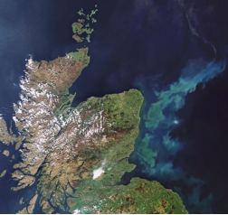
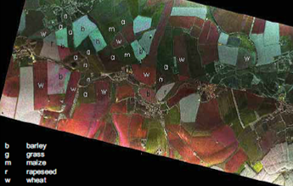
EO Satellites
Optical
Sees what the human eye can see
Needs fine weather
RADAR (RAdio Detection And Ranging)
Can penetrate cloud cover
Works at night
Image needs processing
Source: ESA
Source: SSTL NovaSAR
brochure
Notes:
Pros of RADAR are: all weather, 24/7 coverage; very high resolutions achievable through SAR; false colouring to help highlight key areas, quadruple polarisation to get 4 images at once.
Cons of RADAR are: processing of image = time and money + user need/product required must be more clearly defined.
Pros of Optical are: image is more quickly available; shows an image with colours etc that we are familiar with.
Cons of Optical are: needs to be daylight, no cloud cover; not as detailed a picture as SAR

Slide 8
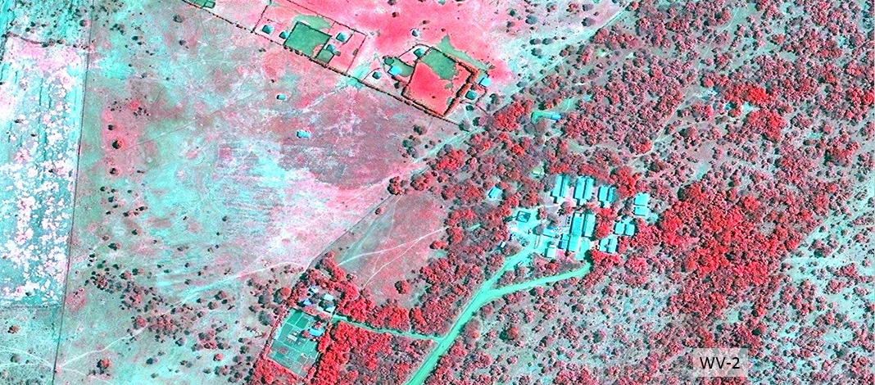
Colours
Notes:
If needs be this can be used to show ‘false’ colouring.
Image taken in Near IR band. Chlorophyll shows as red. Dead/dying plants are lighter red. Building, soil etc (anything not living) is blue.

Slide 9
How many are there?
Committee on Earth Observation Satellites (CEOS) Database includes:
258 Earth observation satellites and
767 instruments
currently operational or planned for launch in next 15 years.
Notes:
Information taken from CEOS http://www.eohandbook.com/

Slide 10
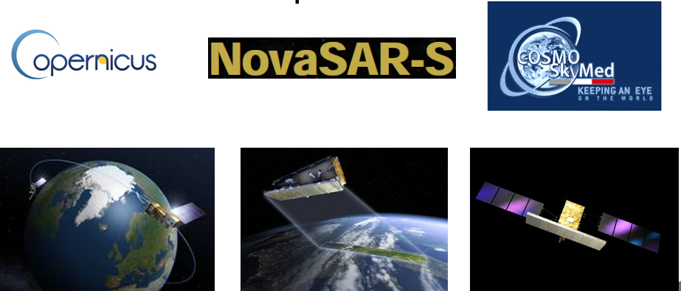
Examples of Current and Future Capabilities
Source: ESA/P. Carril
Source: SSTL
Source: ESA
Notes:
I will be focussing on Copernicus and have left NovaSAR and COSMO SkyMed on the slide as examples of commercially available assets. Also, COSMO can be used for disaster situations.

Slide 11
Copernicus
5 different families of Sentinel satellites, complimenting other remote sensors
Satellites working in pairs, to give better temporal resolution
Includes optical and radar payloads
Best resolution = 5m
Notes:
I would remove all of the swath width stuff and just say WHAT is being monitored and best RESOLUTION
Audience will want to know its sea level or ice etc
What info will Copernicus collect, list of parameters; sea level, ice coverage etc…., when will it be operational? June, July??

Slide 12
Copernicus
Sentinel 1 due to launch on 3 Apr 2014 (RADAR)
Operational by Jul 2014?
Sentinel 2 due to launch in Sep 2014 (Optical)
Sentinel 3 due to launch in Dec 2014 (Optical, RADAR, Altimetry)
Sentinel 4 2018 - 2024??
Sentinel 5 2019?
Notes:
This info is taken from the Copernicus website http://www.copernicus.eu/ and the CEOS Database http://www.eohandbook.com/

Slide 13
Copernicus
Provision of services in 6 main domains
Maritime
Land
Atmosphere
Emergency response
Security
Climate change
Products delivered under these services not fully defined
Notes:
Examples of parameters:
Sentinel 1 – monitoring oil spills, sea ice, marine winds and waves, land use change, land deformation and respond to emergencies such as floods and earthquakes.
Sentinel 2 – monitor vegetation changes during growing season, land management, disaster control and humanitarian relief. Can also be used to produce land-coverage maps, land change detection maps and geophysical variables that use leaf area index, leaf chlorophyll content and leaf water content. Will also provide images of floods and volcanic eruptions.
Sentinel 3 – used to determine global sea surface temperature to 0.3K; measure sea-surface topography; sea and land temperature; and ocean and land surface colour.
Sentinel 4/5 – used to determine atmospheric composition. Services include: monitoring air quality; stratospheric ozone; solar radiation; and climate monitoring.
Products are designed to be Global, Pan-European and Local. Defra Copernicus user groups are helping to define these products.

Slide 14
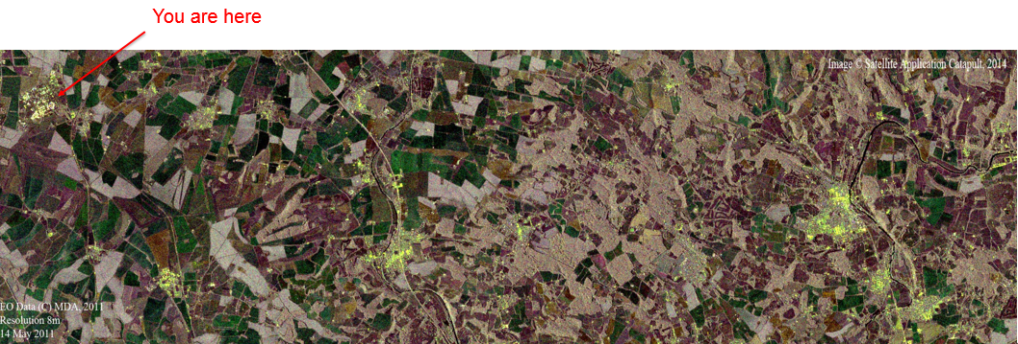
Example of Sentinel imagery
Notes:
This image can be used to show how false colours can be applied to radar imagery.
This is a quad polarisation image (1 image taken in 4 polarisations) taken in the C-Band with 8m resolution. 3 of the polarisation types are assigned a colour (R, G or B) and these synthetic colours help us pick out detail from the different polarisations.
This is part of a data set used to help image analysts etc get used to what Sentinel will offer.

Slide 15
Where do I get data?
How would I chose the right data source?
How do I access the data?
User choice often by data availability / cost/ resolution / data or product etc
Ask neutral experts – Catapult or SSGP –or go directly to supplier
Data discovery and access routes will be made much clearer through this programme – but
Notes:
Ok so you will have blinded them with info- need to give them some reassurance its not too bad to get started!

Slide 16
Alice Bunn

Slide 17
Data Access- for all?
For Copernicus all info at http://gmesdata.esa.int
Copernicus website http://www.copernicus.eu/pages-principales/overview/
UK will be in a unique position because Data can be downloaded here in Catapult and will be archived (on contract to ESA) at Farnborough.
Access TO DATA AND SERVICES?? is free of charge --- CHECK ????

Slide 18
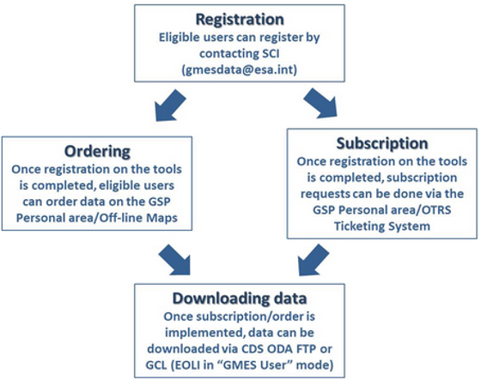
Copernicus Data Access
Source: http://gmesdata.esa.int/web/gsc/how-to-access-gsc-data

Slide 19
NovaSAR
Not yet launched (late 2015/early 2016?)
likely to be a series of satellites to improve coverage and temporal resolution
UK Government has free access to some of the data – and this includes ‘tasking’
4 operating modes
ScanSAR – 100km swath width, 20m spatial resolution
Maritime surveillance – 750km swath width, 30m spatial resolution
Stripmap – 15-20km swath width, 6m spatial resolution
ScanSAR (Wide) – 140km swath width, 30m spatial resolution
Notes:
Be realy careful with these data – a huge element of SO WHAT – What can I see with that and it just fills the slildes

Slide 20
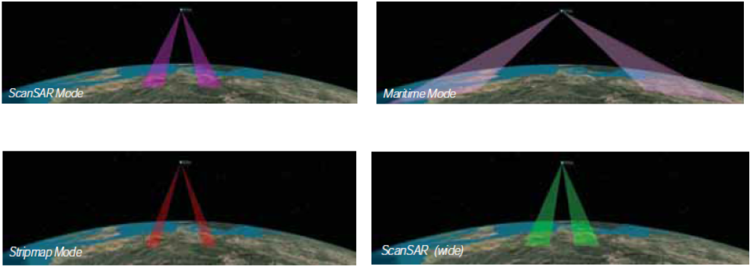
NovaSAR
Source: SSTL NovaSAR brochure

Slide 21
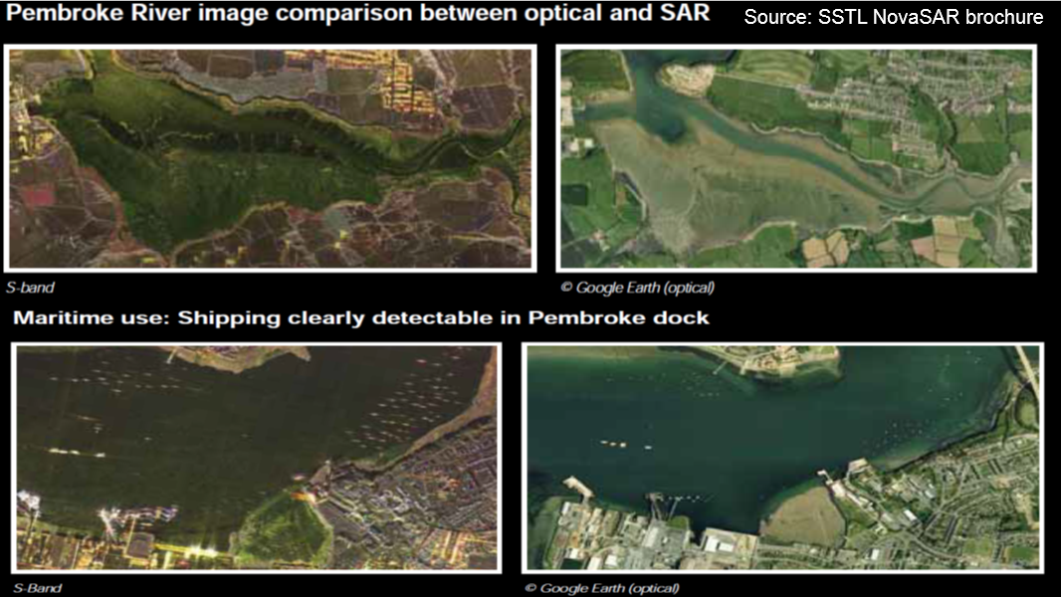
Source: SSTL NovaSAR brochure

Slide 22
Catapult funding NERC aeroplane with airborne NOVASAR RADAR to get simulated data for research purposes, to get people ready for NOVASAR (launch end 2015/early 2016?)
There is a Government user group being established

Slide 23
COSMO-SkyMed
4 x high resolution SAR satellites ie a RADAR satelliet that can see through clouds
6 x scan mode - 100m to 1m spatial resolution
Temporal resolution – 16 days

Slide 25
COSMO SkyMed
Complete constellation can acquire 1800 images daily at
1500 wide field
300 narrow field
Each satellite can acquire
Up to 75 SPOTLIGHT images
Up to 375 STRIPMAP or 150 SCANSAR images

Slide 26
Data Access
COSMO SkyMed website http://www.cosmo-skymed.it/en/index.htm
Go to e-GEOS website to register for data access http://www.cosmo-skymed.it/en/index.htm
COSMO data is not free, yet.
Email address on e-geos website to register for catalogue of archive.
See also http://earth.esa.int/EOLi/EOLi.html for image archive
Notes:
We cant be advocating a particular commercial service – need to put this into contact of many commercial service providers – This is an Itatilon constellation – which we now have a deal on using in some cases -

Slide 27
Galileo
European alternative to GPS (USA) and Glonass (Russian)
Provision of
Open and free to use signal
Public Regulated Service: encrypted signal for secure navigation
Search and Rescue Service
Fee based commercial services
Safety-of-Life Service
The ‘kit’ to receive the signal is in your smart phone, the applications are endless
Notes:
Ref Breakout B

Slide 28
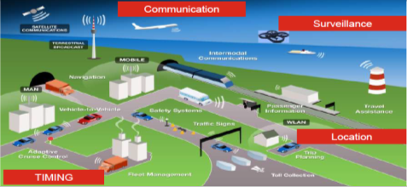
EGNOS (European Geostationary Navigation Overlay Service)
Pan-European Satellite Based Augmentation System (SBAS)
Augments US GPS with Galileo constellation and series of ground stations
Provides information on the reliability of the signal
Increased positioning accuracy to 1.5m, from 10s of metres
AVAILABLE NOW

Slide 29
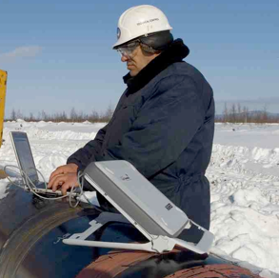
Satellite Communications
Direct to home (DTH) broadcasting
HDTV and digital TV
Broadband communications
Including broadband global area network (BGAN) creation
Enables affordable broadband communications in remote areas
Telephony and data applications
2-way communications between remote areas is achievable
Source: www.satphone.co.uk
Notes:
Kit is becoming cheaper and smaller.
Sending data when in the field is easier as is communicating with remote areas. Ref breakout C.

Slide 30
FUNDING
Space applications are ubiquitous – cover a wide range of sectors and organisations
BIS list 750 support mechanisms for support
TSB list 17 categories of support
European sources of support are numerous
A few are illustrated here

Slide 31
POTENTIAL SPACE FUNDING EUROPE
ARTES http://artes-apps.esa.int/
ARTES 20 Integrated Applications Promotion (IAP)
These are applications that combine (or 'integrate') data from at least two existing and different space assets, such as Satellite Communication, Earth Observation, Satellite Navigation
ARTES 20 Integrated Applications projects cover Feasibility Studies and Demonstration Projects.
Any organisation can propose to develop a new commercially promising space-based application or service. It may be e.g. a federation of users, a commercial company, a public body or a non-governmental organisation.

Slide 32
Artes (continued)
Feasibility studies can be 100% funded
Fast track feasibility studies are 50% funded
Demonstration projects are 50% funded
MAIN CONTACTS – Andy Germain TSB Ian Downey ESA

Slide 33
POTENTIAL SPACE FUNDING UK
Technology Strategy Board https://www.innovateuk.org/funding-support
Collaborative research and development projects
Co-funds business and researchers to work together
Typically £1million projects
Feasibility studies
Co-funds businesses to investigate the technical feasibility of a new idea
Typically £100k projects
Innovation vouchers
Encourage businesses to look outside their network for new knowledge
£6 million funding
Small business research initiative
Helps connect public sector challenges with innovative ideas from industry
Increasing the value of SBRI contracts to £200m in 2014/15.

Slide 34
HORIZON 2020
Flagship EU Research and Innovation programme €80 billion of funding available over 7 years (2014 to 2020)
Space research to foster industry and the research community to exploit space infrastructure to meet policy and societal needs.
Several public-public partnerships will also be developed.
Several space related calls are open or will open shortly
MAIN CONTACT Robert Lowson

Slide 35
Your OWN RESOURCES
UK Government directly fund research involving space assets
Examples are
Defra
Natural England
JNCC
Ultimately we can help you get started/ trial use and assess benefits but you must make your own assessment of need and internal business case to continue to use the satellite service or data.

Slide 36
HOW SSGP CAN HELP
Understand funding pots
Help prepare business cases
Find partners and build consortia
Help tender / develop proposals
Monitor and track progress

Slide 37
NEXT STEPS ON FUNDING
Contact SSGP team
Discuss new ideas for projects
Seek assistance on current project development

Slide 38
Who is who in the Space Landscape
ESA
UKSA
TSB
Commercial suppliers

Slide 39
Conclusion
Plenty of existing data (free and commercial) and some exciting new opportunities
Using satellite data will not cost the Earth
Applications are limited by imagination
There are people to ask: SSGP Team, TSB or Catapult

